Slide 1
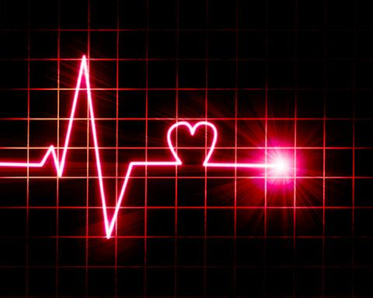
Electrocardiogram (ECG) NOTES
UNIT 5 DAY 6

Slide 2
Regulation of Cardiac Cycle
Baseline heart rate set by SA Node pacemaker cells
Changes to this baseline heart rate regulated by cardiac center within the medulla oblongata. Monitors:
Blood ion levels (ex: potassium, calcium)
Blood CO2 & O2 levels
Muscle Activity
Body Temperature

Slide 3
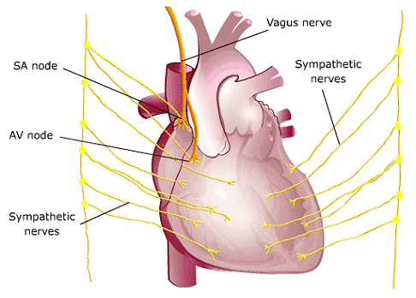
Regulation of Heart RATE
Parasympathetic stimulation
Innervated by the vagus nerve
Decreases heart rate
NT: acetylcholine (Ach)
Sympathetic stimulation
Increases heart rate and force of contraction.
NT: Epinephrine and norepinephrine

Slide 4
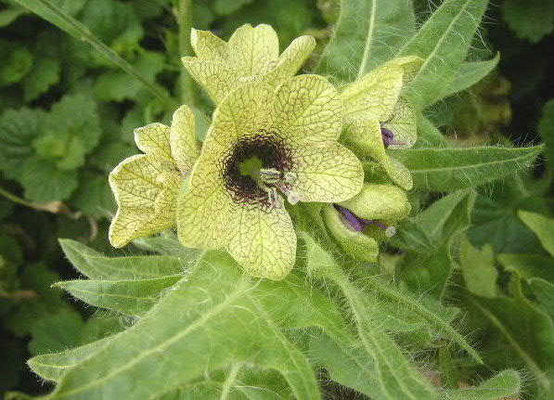
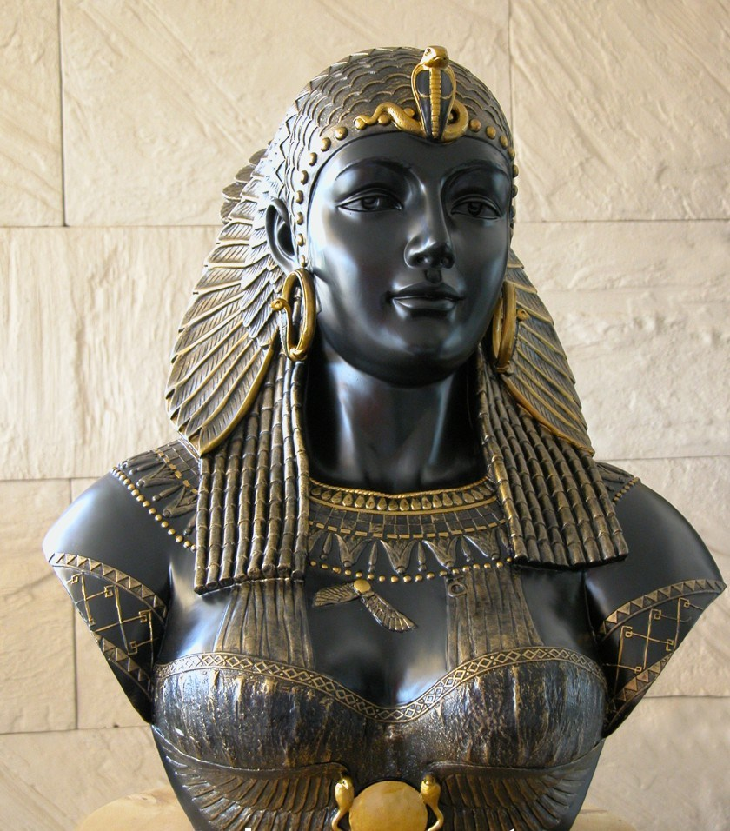
HISTORICAL CONNECTIONS
Atropine, a plant extract (nightshade), blocks Ach receptors, and hence, parasympathetic activity to INCREASE heart rate. Used to treat bradycardia.
Popularly used by Cleopatra and Renaissance women to dilate their pupils and appear more “alluring.”

Slide 5
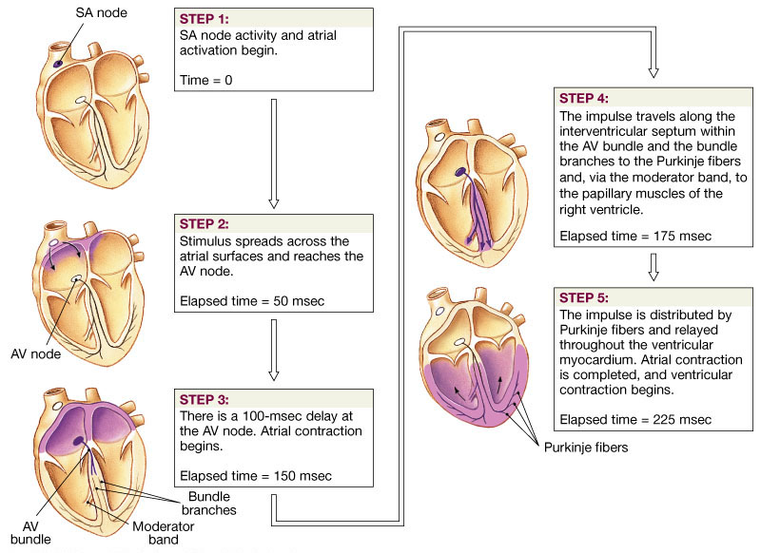
Impulse Conduction through the Heart

Slide 6
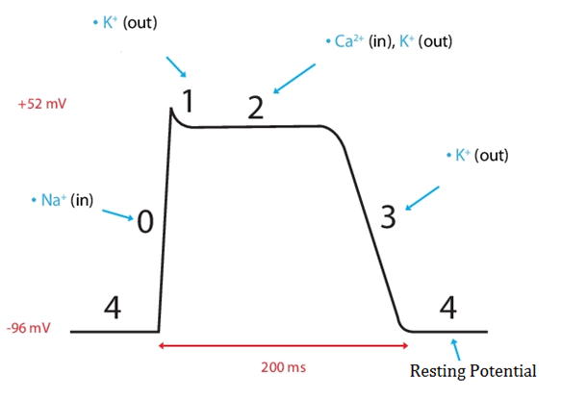
Remember…
Molecules do NOT like being crowded and will move to the LESS crowded side
Depolarization: Sodium IN, Calcium IN
Repolarization: Potassium OUT

Slide 7
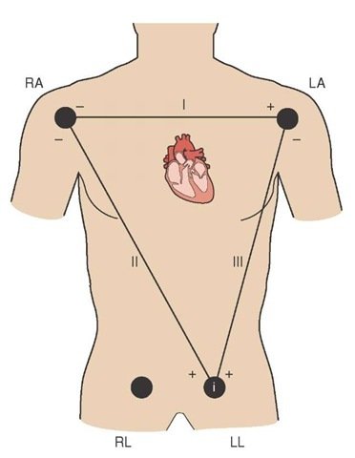
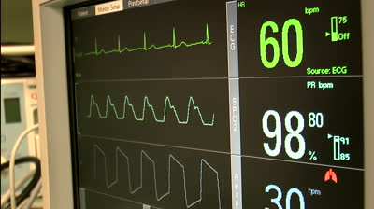
3-Lead ECG Placement
Electrodes measure electrical activity of the heart

Slide 8
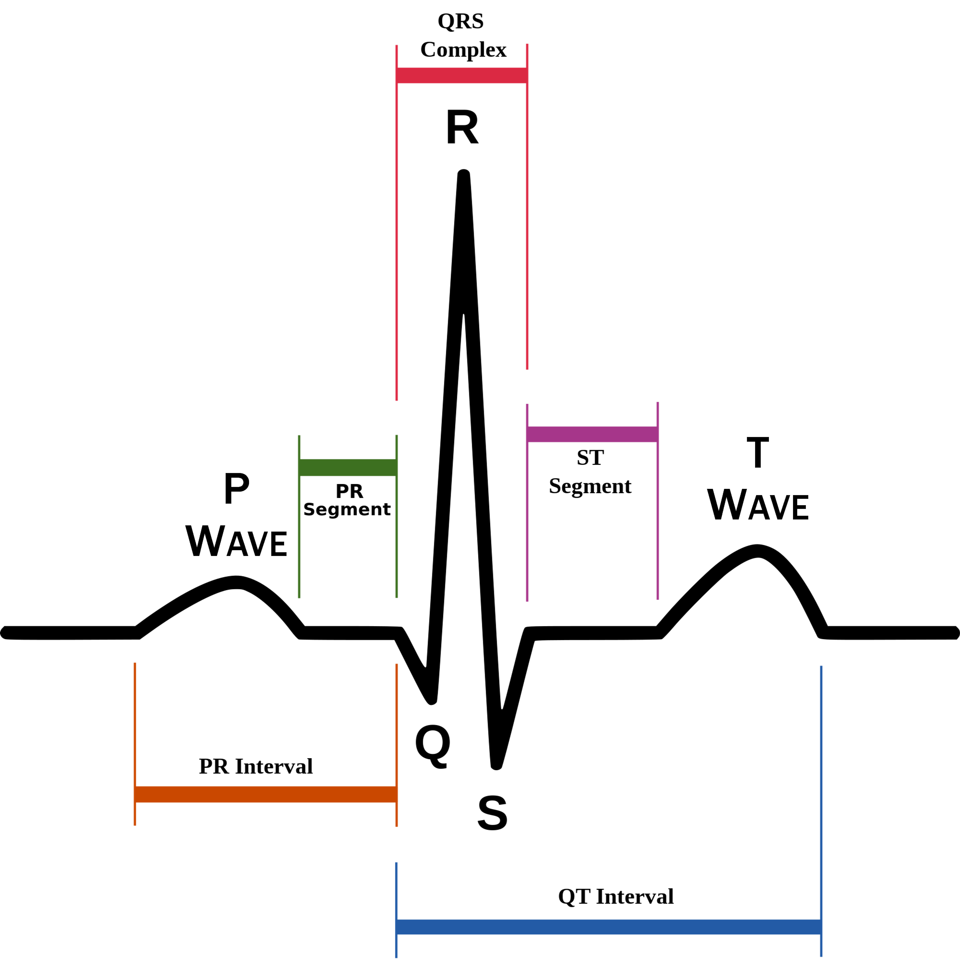
ECG (electrocardiogram) – a recording of the electrical events during a cardiac cycle
P Wave – depolarization of the atria
atrial contraction
ventricular relaxation or diastole
QRS Complex – depolarization of the ventricles
Leads to ventricular contraction or systole
atrial relaxation
T Wave – Repolarization of the ventricles

Slide 9
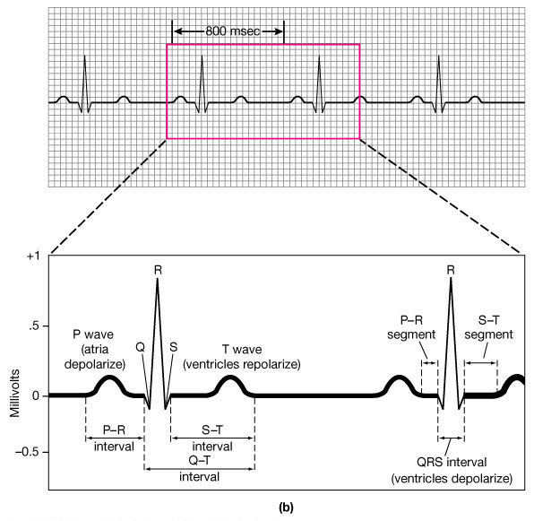
ECG
P-R Interval – impulse conduction from SA → AV Node to Purkinje fibers, including AV delay (about .12 - .2 seconds)
Q-T Interval – total time from ventricular depolarization to repolarization → leads to ventricular contraction or systole
S-T Interval – ventricular repolarization or diastole
T-P Interval – end of systole to start of next contraction. Heart completely at rest and atria filling with blood

Slide 10
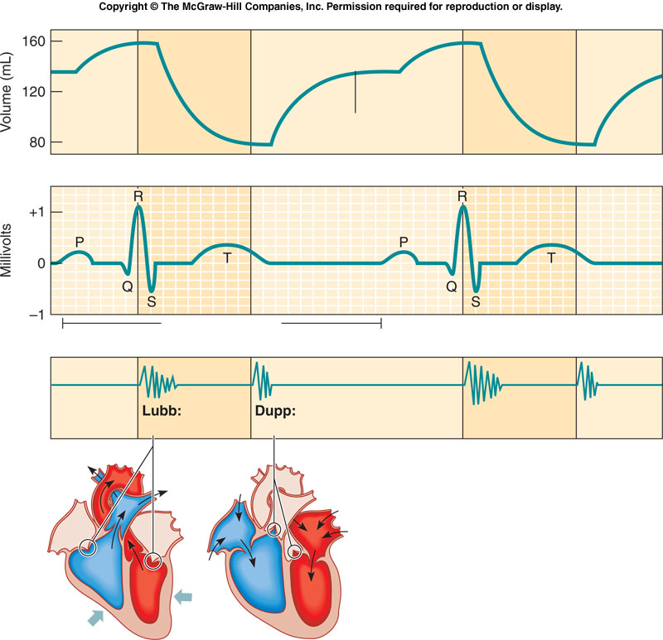

Slide 11
Interpreting ECGs
An ECG is printed on paper covered with a grid of squares.
Notice that five small squares on the paper form a larger square. The width of a single small square on ECG paper represents 0.04 seconds.
A common length of an ECG printout is 6 seconds; this is known as a "six second strip."

Slide 13
Analyze an ECG
Tachycardia – rapid heart rate (>100bpm)
Bradycardia – slower than normal heart rate (<60 bpm)
Commonly seen in athletes → healthy
Arrhythmia – abnormal heart contraction

Slide 14
ECG: Normal and Abnormal
Absent P-Wave. Electrical stimulation starts at AV node.
→ Bradycardia, lightheadedness, hypotension
Elevated S-T segment indicates ischemia (cut-off of blood flow) or myocardial infarction

Slide 15
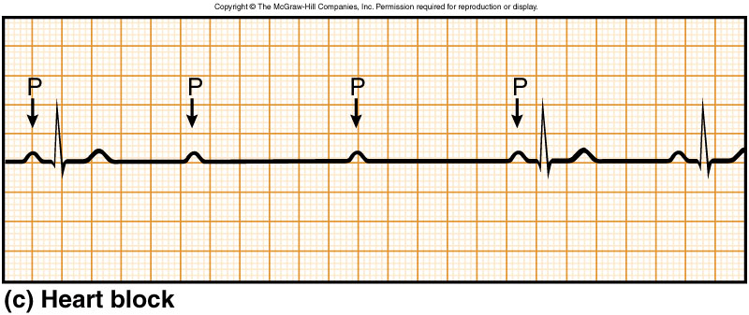
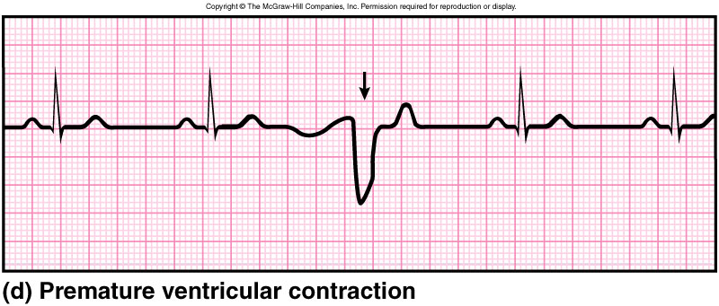
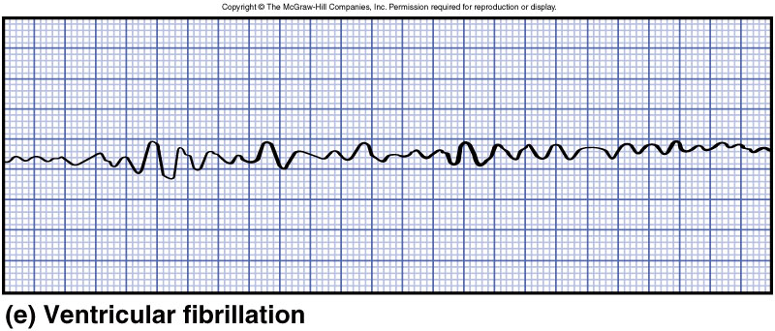
Absent QRS complex
QRS complex following previous QRS+T-wave
Electrical activity of the heart going haywire

Slide 16
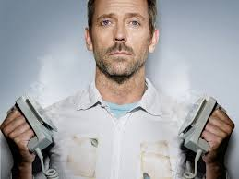
Defibrillator
Common treatment for life-threatening cardiac arrhythmia
The device shocks the heart with high energy voltage, stopping it momentarily
This allows the heart (SA Node) to “reset” and (hopefully) re-establish normal electrical rhythm

Slide 17
Spark of Life
http://www.pbs.org/wnet/heart/educators/video-spark.html

